Slide 1
Introduction to Stock Synthesis
Richard Methot
Science Advisor for Stock Assessments
NOAA Fisheries
Seattle, WA

Slide 2
Objectives of stock assessment
CATCH
Commercial,
Recreational,
Bycatch (Observers)
ABUNDANCE
NOAA VESSEL and CHARTER SURVEYS,
FISHERY CATCH RATE
BIOLOGY
AGE, GROWTH,
MATURITY
ADVANCED MODELS
HABITAT
CLIMATE
ECOSYSTEM
MANMADE STRESS
POPULATION MODEL
Calculates time series of
Fish Abundance and Mortality
SOCIOECONOMICS
STATUS
Overfishing?
Overfished?
FORECAST
Annual Catch Limit

Slide 3
Integrated Analysis
Long time series of quality catch-at-age and index data are often not available. In response we may:
Truncate time series to shorter period; losing contrast
Create catch-at-age from inadequate data sources; losing sense of imprecision
Switch to biomass dynamics model with simple parameters linked to population r & K
Integrated analysis can:
Span data-poor historical periods and current data-rich era
Compare its expected values to a wide variety of data types
Link to population dynamics through spawner-recruitment

Slide 4
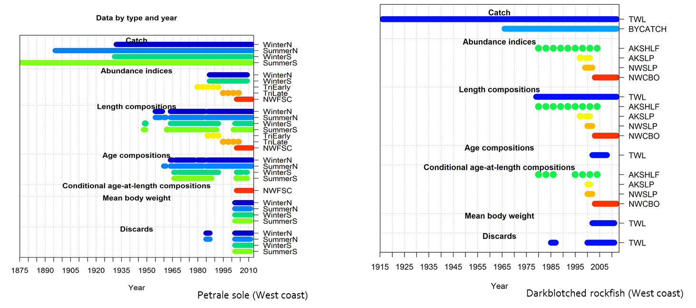
Why Integrated Analysis?
Data available only for some years

Slide 5
IA – SCAA Comparison
SCAA is built around the use of fishery catch-at-age
IA is broader and more flexible concept
Biological characteristics of catch can be represented by size composition, weight composition, or data-free (biomass dynamics model)
Multiple fleets routinely included
Predators can be additional sources of mortality
Alternative information sources (tag-recapture)
Spatial dynamics and movement
Less empirical input (such as body wt-at-age)
More modeling of processes (growth, size-selectivity, ageing imprecision)

Slide 6
History of Integrated Analysis
Fournier & Archibald (1982) provided explicit consideration of errors and use of auxiliary information.
CAGEAN (Deriso et al 1985) - 10s of parameters
Stock Synthesis (Methot, 1989) -10s to 100s of parameters; FORTRAN & numerical derivatives
AD Model Builder (late 1980s) - Computer software to build your own IA, 10s to 1000s of parameters. www.admb-project.org
MULTIFAN-CL (1998) - 1000s of parameters (age and size, tag recapture, movement)
ASAP (Legault& Restrepo, 1998). A flexible forward age-structured assessment program.
Coleraine (Hilborn, Maunder et al, 2000) – comparable to ASAP
CASAL (Bull et. al 2004; New Zealand) C++ algorithmic stock assessment laboratory); age and size structured, tag recapture, movement
GADGET (Begley & Howell, 2004) Globally applicable Area-Disaggregated General Ecosystem Toolbox
Stock Synthesis (Methot, 2005; Methot and Wetzel 2013) – ADMB-based; size & age based model with spatial structure, gender and growth-morphs

Slide 7
SS History - 1984
Coded in FORTRAN
Specific model for anchovy off California
Low F, diverse data
Temperature effects on maturation and selectivity
M = f(predator abundance)

Slide 8
SS History - 1988
Two generalized models coded in FORTRAN
SYNL: Size-age structured, allows size and age selectivity, estimates growth parameters
SYNA: Age-area structured, empirical body weight input, age selectivity, allows multiple areas with estimable movement rates
Target species: west coast groundfish
Long-lived, some 50+ yr old fish still in data
Weak historical data, except catch, but discarding significant
More size than age data; ageing imprecise

Slide 9
SS History – 2003 to present
Generalized model coded in C++ with ADMB
Merged and expanded features for age/size/area
Target species: diverse
Now SS3.24Y (Fall 2015), just call it “SS”
SS3.30 coming soon
SS_nextgen in formative stage

Slide 10
Benefits of Stock Synthesis
Flexible range of options for many population processes
Integrates many sources of data
Propagates uncertainty well
Works well from very simple to very complex models
Widely used
Evolving based on decades of development and exploration

Slide 11
Benefits of widespread use (of any modeling platform)
Bugs less likely to escape notice
More comparison with other models
More development of associated tools (e.g. for making plots)
Facilitates sharing knowledge
common language among many scientists
more advice on building models
easier to understand each others’ results

Slide 12

Stock Synthesis usage
hake, about 20 groundfish species
cod, flatfish
groundfish,
surfclam
tuna
more groundfish
shrimp
grouper,
menhaden
tuna, marlin
anglerfish, sardine, hake
tuna, sharks, small pelagics
mackerel, tuna
tuna, sharks
tuna
snapper
Many stocks in Chile & Argentina
sharks, toothfish, various strange Australian fish

Slide 13
VPA vs. SCAA
Calibrated VPA
Estimates abundance of the oldest age and current cohorts
Calculates abundance back in time
Assumes negligible error in the catch at age
F-at-age mostly unconstrained
SCAA
Estimates initial abundance at age, recruitments, fishing mortality, selectivity
Calculates abundance forward in time
Allows error in the catch at age

Slide 14
Fundamental Processes
Mortality: M and F
Production: R
Catchability/Selectivity

Slide 15
Population Scenario
What process’ parameter is causing this deviation?

Slide 16
Equally Likely Solutions
So, productivity, mortality and selectivity are confounded
Attempt to estimate all 3 parameters with one datum would produce parameter correlation near 1.0
Unique solutions require more data with sufficient contrast along relevant dimensions

Slide 17
IA: No Magic Bullet
Allows many kinds of data, but data does not assure contrast
Allows many processes to be investigated, but cannot magically remove confounding
Fixing parameter values for some processes (M) will tighten confidence intervals by excluding some alternative explanations for the data
Result probably will have more variance than result from a simpler model – that’s good
A fishery interacting with its ecosystem is complex process; our models should not overly simplify this process just because the data are lacking

Slide 18
Tuning a Model
Result will be a complex weighted average of fit to all included data;
Type, contrast and precision of data determine its influence
Examine residuals and root mean squared error of fit to data
Parsimoniously, add enough process to remove pattern to residuals
Judicious re-weighting of inputs to make error assumptions consistent

Slide 19
Bring model to the data
Don’t transform data to meet rigid model structure
Do add processes to model to develop expected values for diverse, lightly processed data
Improves understanding of processes
Allows simultaneous use of more types of data
Statistical properties of data are preserved and transferred to variance of final model results

Slide 20
Age-Length Structured Population
Notes:
20
Let’s explore the concept of length and age based modeling in more detail
The left panel shows the numbers at age in the population distributed across lengths according to the mean growth curve and population variance about this curve. I’ve put a larger, non-equilibrium number at age 5 to aid in the demonstration.
We’ll sample this population with this size-selectivity curve

Slide 21
Sampling & Observation Processes
Notes:
The result on the left is a size-selective sample of the population, the smallest fish are gone
Now we cannot exactly observe the real age of fish, There is imprecision as described by Bill Clark this morning. Here on the right we see the catch at observed age is blurred along the age axis. Some misaged 5 year olds have inflated the apparent occurrence of 4 and 3 year olds.
What I’ve shown is a representation of actual processes at work to generate our data;
in order to assure unbiased results, we need to engineer these same processes into the model to generate expected values that are truly comparable to the data. We build the process into the model rather than attempt to transform the data.
The next step is to accumulate these expected values to either the length or the age’ axis.

Slide 22
Expected Values for Observations
Notes:
22
Reminder in the upper left is the size selectivity
The lower left shows the size composition in the population and in the sample
The upper right shows the age composition in the population, in the sample, and as observed by our age determination process
Finally, the lower right shows the necessary consequences of these biologically realistic factors on mean size at age in the population, the sample and as observed by our age determination process

Slide 23
Stock Synthesis Structure
NUMBERS-AT-AGE
Cohorts: gender, birth season, growth pattern;
“Morphs” can be nested within cohorts to achieve size-survivorship;
Distributed among areas
AREA
Age-specific movement between areas
FLEET / SURVEY
Length-, age-, gender selectivity
CATCH
F to match observed catch;
Catch partitioned into retained and discarded, with discard mortality
RECRUITMENT
Expected recruitment is a function of total female spawning biomass;
Optional environmental input;
apportioned among cohorts and morphs;
Forecast recruitments are estimated, so get variance
PARAMETERS
Can have prior/penalty;
Time-vary as time blocks, random annual deviations, or a function of input environmental data
Notes:
23
So, let me recap SS2 structural features

Slide 24
Stock Synthesis Data
Retained catch
CPUE and survey abundance
Age composition
Within length range
Size composition
By biomass or numbers
Within gender and discard/retained
Weight bins or length bins
Mean length-at-age
Discard (% or total)
Mean body weight
Tag-recapture
Stock composition
Notes:
24

Slide 25
Fitting to data
The goal is estimate the underlying process, given that observations have uncertainty and process has fluctuations
Minimize the difference
{
Prediction

Slide 26
Stock assessment using the software “Stock Synthesis”
NWFSC

Slide 27
Objectives of stock assessment
CATCH
Commercial,
Recreational,
Bycatch (Observers)
ABUNDANCE
NOAA VESSEL and CHARTER SURVEYS,
FISHERY CATCH RATE
BIOLOGY
AGE, GROWTH,
MATURITY
ADVANCED MODELS
HABITAT
CLIMATE
ECOSYSTEM
MANMADE STRESS
POPULATION MODEL
Calculates time series of
Fish Abundance and Mortality
SOCIOECONOMICS
STATUS
Overfishing?
Overfished?
FORECAST
Annual Catch Limit

Slide 28
Types of data
Catches
Guesstimate on depletion
Discards
Effort
Indices of abundance (fishery and/or survey)
Absolute abundance
Catch-at-age with ageing error
Catch-at-length
Age-conditional-on-length
Average length-at-age, average weight-at-length
Average weight, average length
Tagging

Slide 29
Modeler’s Goal
The goal is estimate the underlying process from obs that have measurement error, and while accepting that process has fluctuations
Observation
Prediction

Slide 30
Components of population dynamic models
State variables: In the future depend on
Current state
Parameters
Forcing (external shocks)
Rules of change (equations)
Rules of change
Forces
(e.g. catches,
env.)
State variables in
next time period
State variables
(e.g., numbers)
Parameters
(e.g., growth rate)

Slide 31
Sources of error, e.g. uncertainty
Observation error (sampling and measurement error)
Process error (dynamics of the resource and the fishery)
Model error (model’s ability to capture dynamics)
Structure of the error (error distributions in likelihood)
Estimation error (accuracy of the model parameters)
Implementation error (management differs from intended)

Slide 32
Methods
Estimation of parameters
Moments
Least squares
Maximum Likelihood (MLE)
Bayesian (MCMC)
Estimation of uncertainty
Delta method
Bootstrap
Asymptotic theoretical variance (MLE)
Likelihood profile (MLE)
Posterior distribution (Bayesian)

Slide 33
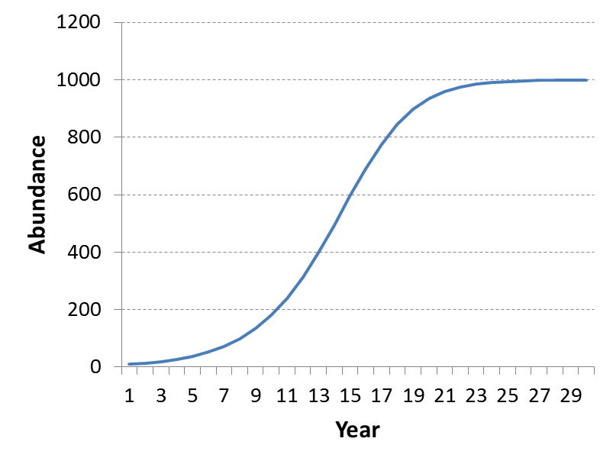
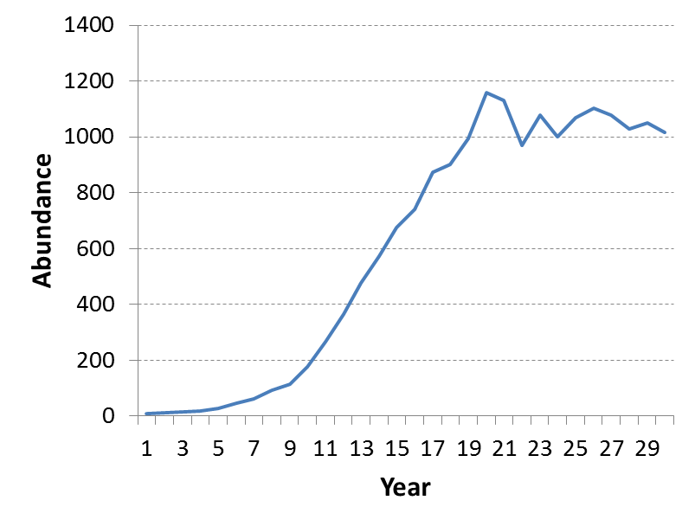
Deterministic or stochastic process error
Should there be random process error?
Deterministic model (no process error)
Stochastic model (with process error)
where w_{t} is a random variable
(typically a normal distribution)

Slide 34
Observation error
From sampling and measurement error
Individual observation error for each piece of data

Slide 35
Process error
Natural variation (time-specific variation)
Recruitment variability
Natural mortality
Selectivity
Growth

Slide 36
Model error
All models are simplifications
We may not fully understand the dynamics of the system
There may be important differences between the model and reality
It is usually not considered in the stock assessment
Absorbed into the process and observation error.

Slide 37
Implementation error
Implications due to failure to implement the agreed upon management actions
Important in decision analysis and projections
Often account for this in Management Strategy Evaluation (MSE)

Slide 38
Model the error
Models can assume known observation and/or process error
Observation error models
regression
Process error models
assume no or known observation error
Models with both errors
State-space models
Integrated analysis models like SS

Slide 39
VPA vs. SCAA
VPA vs SCAA
Calibrated VPA
Estimates abundance of the oldest age and current cohorts
Calculates abundance back in time
Assumes negligible error in the catch at age
F-at-age mostly unconstrained
SCAA
Estimates initial abundance at age, recruitments, fishing mortality, selectivity
Calculates abundance forward in time
Allows error in the catch at age

Slide 40
Integrated Analysis
Long time series of quality catch-at-age and index data are often not available. In response we may:
Truncate time series to shorter period; losing contrast
Create catch-at-age from inadequate data sources; losing sense of imprecision
Switch to biomass dynamics model with simple parameters linked to population r & K
Integrated analysis can:
Span data-poor historical periods and current data-rich era
Compare its expected values to a wide variety of data types
Link to population dynamics through spawner-recruitment

Slide 41
Why Integrated Analysis?
Data available only for some years

Slide 42
IA – SCAA Comparison
SCAA is built around the use of fishery catch-at-age
IA is broader and more flexible concept
Biological characteristics of catch can be represented by size composition, weight composition, or data-free (biomass dynamics model)
Multiple fleets routinely included
Predators can be additional sources of mortality
Alternative information sources (tag-recapture)
Spatial dynamics and movement
Less empirical input (such as body wt-at-age)
More modeling of processes (growth, size-selectivity, ageing imprecision)

Slide 43
History of Integrated Analysis
Fournier & Archibald (1982) provided explicit consideration of errors and use of auxiliary information.
CAGEAN (Deriso et al 1985) - 10s of parameters
Stock Synthesis (Methot, 1989) -10s to 100s of parameters; FORTRAN & numerical derivatives
AD Model Builder (late 1980s) - Computer software to build your own IA, 10s to 1000s of parameters. www.admb-project.org
MULTIFAN-CL (1998) - 1000s of parameters (age and size, tag recapture, movement)
ASAP (Legault& Restrepo, 1998). A flexible forward age-structured assessment program.
Coleraine (Hilborn, Maunder et al, 2000) – comparable to ASAP
CASAL (Bull et. al 2004; New Zealand) C++ algorithmic stock assessment laboratory); age and size structured, tag recapture, movement
GADGET (Begley & Howell, 2004) Globally applicable Area-Disaggregated General Ecosystem Toolbox
Stock Synthesis (Methot, 2005; Methot and Wetzel 2013) – ADMB-based; size & age based model with spatial structure, gender and growth-morphs

Slide 44
Bring model to the data
Don’t transform data to meet rigid model structure
Do add processes to model to develop expected values for diverse, lightly processed data
Improves understanding of processes
Allows simultaneous use of more types of data
Statistical properties of data are preserved and transferred to variance of final model results

Slide 45
Estimation, Benchmarks, Forecasts
Sometimes we use a sequence of separate analyses:
Estimate population abundance time series
Calculate benchmark quantities: target and limit F rates, sometimes based on first fitting spawner-recruitment curve.
Forecast future abundance and catch using the target F
Integrated Analysis can:
Bring all steps into one analytical package
Parameter variance from population estimation gets propagated to quantities in forecast
Example output: probability that stock abundance will dip below the overfished threshold 5 years into the future, and the standard error of this probability

Slide 46
Integrated analysis sub-models
Population Model
Recruitment, mortality, growth
Age and/or size structured
Observation Model
Derive expected values for data
Likelihood-based Statistical Model
Quantify goodness-of-fit
Algorithm to search for parameter set that maximizes likelihood
Auto-Differentiation Model Builder (ADMB)
Cast results in terms of management quantities
Propagate uncertainty for derived and management quantities

Slide 47
IA: No magic bullet
Allows many kinds of data, but data does not assure contrast
Allows many processes to be investigated, but cannot magically remove confounding
Fixing parameter values for some processes (M) will tighten confidence intervals by excluding some alternative explanations for the data
Result probably will have more variance than result from a simpler model – that’s good
A fishery interacting with its ecosystem is complex process; our models should not overly simplify this process just because the data are lacking

Slide 48
From data to results
Result is a complex function of fit to all included data;
Type, contrast and precision of data determine its influence
Examine residuals and root mean squared error of fit to data
Parsimoniously, add enough process to remove pattern to residuals
Judicious re-weighting of inputs to match rmse of output

Slide 49
Data, penalties, priors
Penalties and Priors are information about parameters in a model
Example: maximum age used to create prior on M
Data are information about a derived quantity
Expected value for this quantity is derived from model parameters and structure
Example: Age composition of catch from a fleet
In IA, the expected value for maximum observed age could be derived as a function of M, then observed maximum age could be included as model data
Concept of Data and Priors blur; it’s all information

Slide 50
Relation to Bayesian analysis
Bayesian Analysis (BA) requires prior pdf for all parameters and integrates across this pdf and the posterior pdf to create a posterior pdf of results
Information (meta-data) typically used to create priors for a Bayesian analysis can be included as likelihood penalties in IA for some, but not necessarily all, parameters
Maximum likelihood (MLE) result is like mode of BA
MCMC with IA’s parameter penalties produces pdf like that of BA
The normal pdf based on the uncertainty of the MLE is comparable to the BA pdf from MCMC, at least in many applications.
What about when the distribution is lognormal?

Slide 51
Stock Synthesis
An implementation of IA
Age and size structured, with geographic areas
High diversity of data types, including tags
Fully integrates population estimation, benchmark calculation, and forecasting

Slide 52
Sources of error/uncertainty
Observation error (sampling and measurement error)
Process error (dynamics of the resource and the fishery)
Model error (model’s ability to capture dynamics)
Structure of the error (error distributions in likelihood)
Estimation error (accuracy of the model parameters)
Implementation error (management differs from intended)

Slide 53
Observation error
From sampling and measurement error
Individual observation error for each piece of data

Slide 54
Process error
Natural variation (time-specific variation)
Recruitment variability
Natural mortality
Selectivity
Growth

Slide 55
Model error
All models are simplifications
We may not fully understand the dynamics of the system
There may be important differences between the model and reality
It is usually not considered in the stock assessment
Absorbed into the process and observation error.

Slide 56
Implementation error
Implications due to failure to implement the agreed upon management actions
Important in decision analysis and projections
Often account for this in Management Strategy Evaluation (MSE)

Slide 57
Model the error
Models can assume known observation and/or process error
Observation error models
regression
Process error models
assume no or known observation error
Models with both errors
State-space models
Integrated analysis models like SS

Slide 58
Components of population dynamic models
State variables: In the future depend on
Current state
Parameters
Forcing (external shocks)
Rules of change (equations)
Rules of change
Forces
(e.g. catches,
env.)
State variables in
next time period
State variables
(e.g., numbers)
Parameters
(e.g., growth rate)

Slide 59
SS – Estimation Procedures
Maximize negative logL using ADMB
logL is user-weighted composite of components from sources (fleets and surveys) and kinds of data (CPUE, age comp, size comp, etc.)
Parameters have user-controlled: min, max, initial value, phase, and optional prior
Capable of MLE, MCMC, parametric bootstrap (but no ADMB-RE and no ADMB likelihood profiles)
Benchmark (MSY, SPR) and forecast done in sd_phase and mceval_phase

Slide 60
Sub-Models of SS
Population Model
Recruitment, mortality, growth
Age and/or size structured
Observation Model
Derive expected values for data
Likelihood-based Statistical Model
Quantify goodness-of-fit
Algorithm to search for parameter set that maximizes the likelihood
Auto-Differentiation Model Builder (ADMB)
Cast results in terms of management quantities
Propagate uncertainty onto confidence interval for management quantities
Parametric bootstrap
Notes:
The general class of models termed Integrated Analysis incorporate a Population Model, an Observation Model, a Statistical Model, and a means to search for the best-fitting set of parameters
Generally, fishing mortality is treated as being separable into a age-specific selectivity and a year-specific level, but there are many permutations on this theme.

Slide 61
Methods
Estimation of parameters
Moments
Least squares
Maximum Likelihood (MLE)
Bayesian (MCMC)
Estimation of uncertainty
Delta method
Bootstrap
Asymptotic theoretical variance (MLE)
Likelihood profile (MLE)
Posterior distribution (Bayesian)

Slide 62
Estimation, Benchmarks, Forecasts
Sometimes we use a sequence of separate analyses:
Estimate population abundance time series
Calculate benchmark quantities: target and limit F rates, sometimes based on first fitting spawner-recruitment curve.
Forecast future abundance and catch using the target F
Integrated Analysis can:
Bring all steps into one analytical package
Parameter variance from population estimation gets propagated to quantities in forecast
Example output: probability that stock abundance will dip below the overfished threshold 5 years into the future, and the standard error of this probability

Slide 63
Data, penalties, priors
Penalties and Priors are information about parameters in a model
Example: maximum age used to create prior on M
Data are information about a derived quantity
Expected value for this quantity is derived from model parameters and structure
Example: Age composition of catch from a fleet
In IA, the expected value for maximum observed age could be derived as a function of M, then observed maximum age could be included as model data
Concept of Data and Priors blur; it’s all information

Slide 64
Relation to Bayesian analysis
Bayesian Analysis (BA) requires prior pdf for all parameters and integrates across this pdf and the posterior pdf to create a posterior pdf of results
Information (meta-data) typically used to create priors for a Bayesian analysis can be included as likelihood penalties in IA for some, but not necessarily all, parameters
Maximum likelihood (MLE) result is like mode of BA
MCMC with IA’s parameter penalties produces pdf like that of BA
The normal pdf based on the uncertainty of the MLE is comparable to the BA pdf from MCMC, at least in many applications.

